Slide 1

ART &
Fertility Massage
Clare Blake N.D.
Fertility Massage Therapy & Training

Slide 2

Types of ART
(Assisted Reproduction Techniques)

Slide 3
ART methods
OI – Ovarian Induction
COS –Controlled Ovarian Stimulation
IUI – intrauterine insemination
IVF – in vitro fertilisation
ICSI – intracytoplasmic sperm injection
Egg Donor or Sperm Donor
Surrogacy

Slide 4
Other ART Methods
IMSI - Intracytoplasmic Morphological Sperm Injection
IVM – in vitro maturation.
Blastocyst transfer
Gift – gamete intra-fallopian transfer
Zift – zygote intra-fallopian transfer
Assisted hatching

Slide 5
IVF Statistics
Pregnancy rate (per embryo transfer) for patients receiving IVF treatment using their own fresh eggs, 2010 and 2011. (www.hfea.gov.uk)
Age | 2010 | 2011
18 – 34 | 41.1% | 40.6%
35 – 37 | 35.9% | 35.5%
38 – 39 | 29.0% | 28.1%
40 – 42 | 21.2% | 21.2%
43 – 44 | 10.3% | 11.2%
45+ | 4.2% | 3.4%
All ages | 34.1% | 33.7%

Slide 6
IVF Statistics
Live birth rate, per cycle started, fresh own eggs,
2009 and 2010. (www.hfea.gov.uk)
Age | 2009 | 2010
18 – 34 | 32.3% | 32.2%
35 – 37 | 27.2% | 27.7%
38 – 39 | 19.1% | 20.8%
40 – 42 | 12.7% | 13.6%
43 – 44 | 5.1% | 5.0%
45+ | 1.5% | 1.9%
All ages | 25.2% | 25.6%

Slide 7
IUI Statistics
IUI statistics of live births in 2010 using sperm donor in IUI
http://www.babycentre.co.uk/a4092/fertility-treatment-intrauterine-insemination-iui#ixzz2r2cBP1A5
Age | 2010
18 - 35 | 15%
35 – 37 | 11%
38- 39 | 9%
40+ | 5%

Slide 8
Ovarian Induction
Used for Women with:
Amenorrhea
Low or low – normal serum FSH
Low serum oestradiol due to low GnRH
PCOS
Aim
To stimulate development of a single follicle that will be able to reach pre-ovulatory size and rupture

Slide 9
Ovarian Induction
Names of Medication
Clomid | HCG
Pregnyl | Ovidrel
Follistim | Menopur
Novarel | Gonal-F
Metformin if PCOS

Slide 10
Controlled Ovarian Stimulation or Hyperstimulation
Medications are used for Women going through an IVF cycle to stimulate the development of multiple follicles.

Slide 11
IUI
intrauterine insemination

Slide 12
IUI
Least invasive
Popular with same-sex couples or sperm donor
Can be performed at home
No drugs normally required
Sperm is washed and injected into womb through a catheter

Slide 13
IUI – Step 1 for Women
If you are not using fertility drugs IUI is done between day 12 and day 16 of your monthly cycle – with day one being the first day of your period. You are given blood or urine tests to identify when you are about to ovulate.
Many clinics will provide you with an ovulation predictor kit to detect the hormone surge that signals imminent ovulation.

Slide 14
IUI – Step 1 for Women
or
If you use fertility drugs to stimulate ovulation, vaginal ultrasound scans are used to track the development of your eggs. As soon as an egg is mature, you are given a hormone injection to stimulate its release

Slide 15
IUI – Step 2 for Women
The sperm are inserted 36 to 40 hours later. To do this, the doctor first inserts a speculum into your vagina (as for a cervical smear test).
A small catheter is then threaded into your womb via your cervix. The best quality sperm are selected and inserted through the catheter.
The whole process takes just a few minutes and is usually a painless procedure but some women may experience a temporary, menstrual-like cramping.

Slide 16
IUI – Steps for Men
Step 1. Men will be asked to produce a sperm sample on the day the treatment takes place.
Step 2. The sperm are washed to remove the fluid surrounding them and the rapidly moving sperm separated out.
Step 3. The rapidly moving sperm are placed in a small catheter to be inserted into the womb.

Slide 17
IVF
in vitro fertilisation

Slide 18
IVF Options
Natural cycle IVF involves collecting and fertilising the one egg that you release during your normal monthly cycle. No fertility drugs are used in this treatment.
With mild stimulation IVF, the woman is either given a lower dose of fertility drugs or is given them over a shorter period than with conventional IVF.

Slide 19
IVF Options
In vitro maturation. In the IVM process, eggs are removed from the ovaries and are collected when they are still immature. They are then matured in the laboratory before being fertilised.
Embryo transfer takes place after eggs have been collected and fertilised in the laboratory. Depending on your situation between one and three of the best quality embryos are selected and then transferred to the woman’s womb

Slide 20
IVF Options
With blastocyst transfer, embryos are cultured in the laboratory incubator to the blastocyst stage before they are transferred to the womb.
Assisted Hatching - It has been suggested that making a hole in or thinning this outer layer may help embryos to ‘hatch’, increasing the chances of the woman becoming pregnant in some cases.

Slide 21
IVF – Overview of Process
Suppressing the natural monthly hormone cycle
Boosting the egg supply
Checking on progress
Collecting the eggs
Fertilising the eggs
Embryo transfer

Slide 22
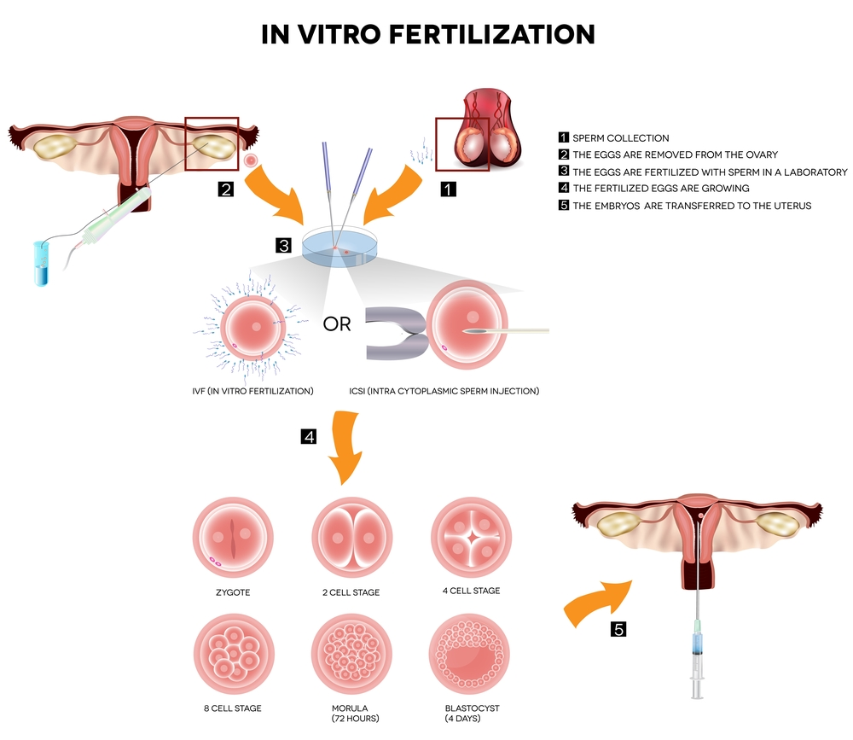

Slide 23
IVF – step 1
Suppressing the natural monthly hormone cycle
As a first step of the IVF process you may be given a drug to suppress your natural cycle.
Treatment is given either as a daily injection (which is normally self-administered unless you are not able to do this yourself) or a nasal spray. This continues for about two weeks.
GnRH is suppressed

Slide 24
IVF – step 2
.
Boosting the egg supply
After the natural cycle is suppressed you are given a fertility hormone called FSH (or Follicle Stimulating Hormone). This is usually taken as a daily injection for around 12 days.
This hormone will increase the number of eggs you produce - meaning that more eggs can be fertilised. With more fertilised eggs, the clinic has a greater choice of embryos to use in your treatment

Slide 25
IVF – step 3
Checking on progress
Throughout the drug treatment, the clinic will monitor your progress. This is done by vaginal ultrasound scans and, possibly, blood tests.
34–38 hours before your eggs are due to be collected you have a hormone injection to help your eggs mature.

Slide 26
IVF – step 4
Collecting the eggs
In the IVF process eggs are usually collected by ultrasound guidance under sedation. This involves a needle being inserted into the scanning probe and into each ovary.
The eggs are, in turn, collected through the needle.
Cramping and a small amount of vaginal bleeding can occur after the procedure

Slide 27
IVF – step 5
Fertilising the eggs
Your eggs are mixed with your partner’s or the donor’s sperm and cultured in the laboratory for 16–20 hours. They are then checked to see if any have fertilised.
Those that have been fertilised (now called embryos) are grown in the laboratory incubator for another one - two days before being checked again. The best one or two embryos will then be chosen for transfer.
After egg collection, you are given Progesterone to help prepare the lining of the womb for embryo transfer. This is given as pessaries, injection or gel.

Slide 28
IVF – step 6
Embryo transfer
For women under the age of 40, one or two embryos can be transferred. If you are 40, or over, a maximum of three can be used.
The number of embryos is restricted because of the risks associated with multiple births.
Remaining embryos may be frozen for future IVF attempts, if they are suitable

Slide 29
IVF – Men
Collecting sperm
Around the time your partner’s eggs are collected, you are asked to produce a fresh sample of sperm.
This is stored for a short time before the sperm are washed and spun at a high speed. This is so the healthiest and most active sperm can be selected.
If you are using donated sperm, it is removed from frozen storage, thawed and prepared in the same way.

Slide 30
ICSI
intracytoplasmic sperm injection

Slide 31
ICSI – Steps for Women
Step 1. You take fertility drugs to stimulate your ovaries to produce more eggs, as for IVF
Step 2. The eggs are then collected and each egg is injected with a single sperm from your partner or a donor. After two to three days in the laboratory, those that are fertilised are transferred to your womb in the same way as for conventional IVF.
Any suitable remaining embryos can be frozen for future use

Slide 32
ICSI – Steps for Men
Step 1. An embryologist will examine the sperm under a microscope and decide whether ICSI could increase their chances of fathering a baby.
Step 2. The next step depends on whether they are able to provide sperm without medical intervention:
If they can, you produce a fresh sperm sample on the same day as their partner’s eggs are collected.

Slide 33
ICSI – Steps for Men
OR
Sperm can be collected directly from the epididymis (a narrow tube inside the scrotum, where sperm are stored and matured) using a type of fine syringe. This is known as ‘percutaneous epididymal sperm aspiration’ or PESA.
Sperm can also be retrieved from the testicles, a process known as ‘testicular sperm aspiration’ or TESA

Slide 34
ICSI – Steps for Men
Step 3. A single sperm is injected into each egg. This does not mean that the egg is fertilised, but ICSI now gives an opportunity for that complex process to commence. ICSI is not a guarantee that fertilisation will take place.
Step 4. Subsequently one - three of the best quality embryos are transferred to the womb

Slide 35
Which Method??
Condition | Method
Female Infertility
Ovulatory failure or dysfunction | Ovarian Induction
Tubal conditions | IVF
Endometriosis | IUI or IVF
Male Infertility
Subfertility | IUI with or without OI
Male Factor | ICSI
Female & Male
Unexplained Infertility | IUI, IVF or ICSI

Slide 36
Fertility Massage Protocols

Slide 37
IUI
Stage of Cycle | Treatment
During Menses | Avoid womb
Until Ovulation & Insemination | Whole Massage
After Insemination | Avoid Womb

Slide 38
IVF & ICSI
Stage of Cycle | Treatment
During Menses | Avoid womb
Suppressing the Cycle | Whole Massage if no tenderness is felt
Boosting Egg Supply & Egg Collection | Whole Massage if no tenderness is felt. Otherwise avoid lower abdomen
After Embryo Transfer | Avoid Womb

Slide 39
Natural Conception
“Actively Trying to Conceive”
Stage of Cycle | Treatment
During Menses | Avoid womb
End of Menses to ovulation | Whole massage
Ovulation to menses or Pregnancy | Avoid womb

Slide 40
Preparation for Conception
“Not actively trying to conceive”
Stage of Cycle | Treatment
During Menses | Avoid womb
End of Menses to ovulation | Whole massage
Ovulation to menses or Pregnancy | Whole massage

